Slide 1
Binary Trees

Slide 2
Tree Terminology
Parent of node n
The node directly above node n in the tree
Child of node n
A node directly below node n in the tree
Root
The only node in the tree with no parent
Subtree of node n
A tree that consists of a child (if any) of node n and the child’s descendants

Slide 3
Tree Terminology
Leaf
A node with no children
Siblings
Nodes with a common parent
Ancestor of node n
A node on the path from the root to n
Descendant of node n
A node on a path from n to a leaf

Slide 4
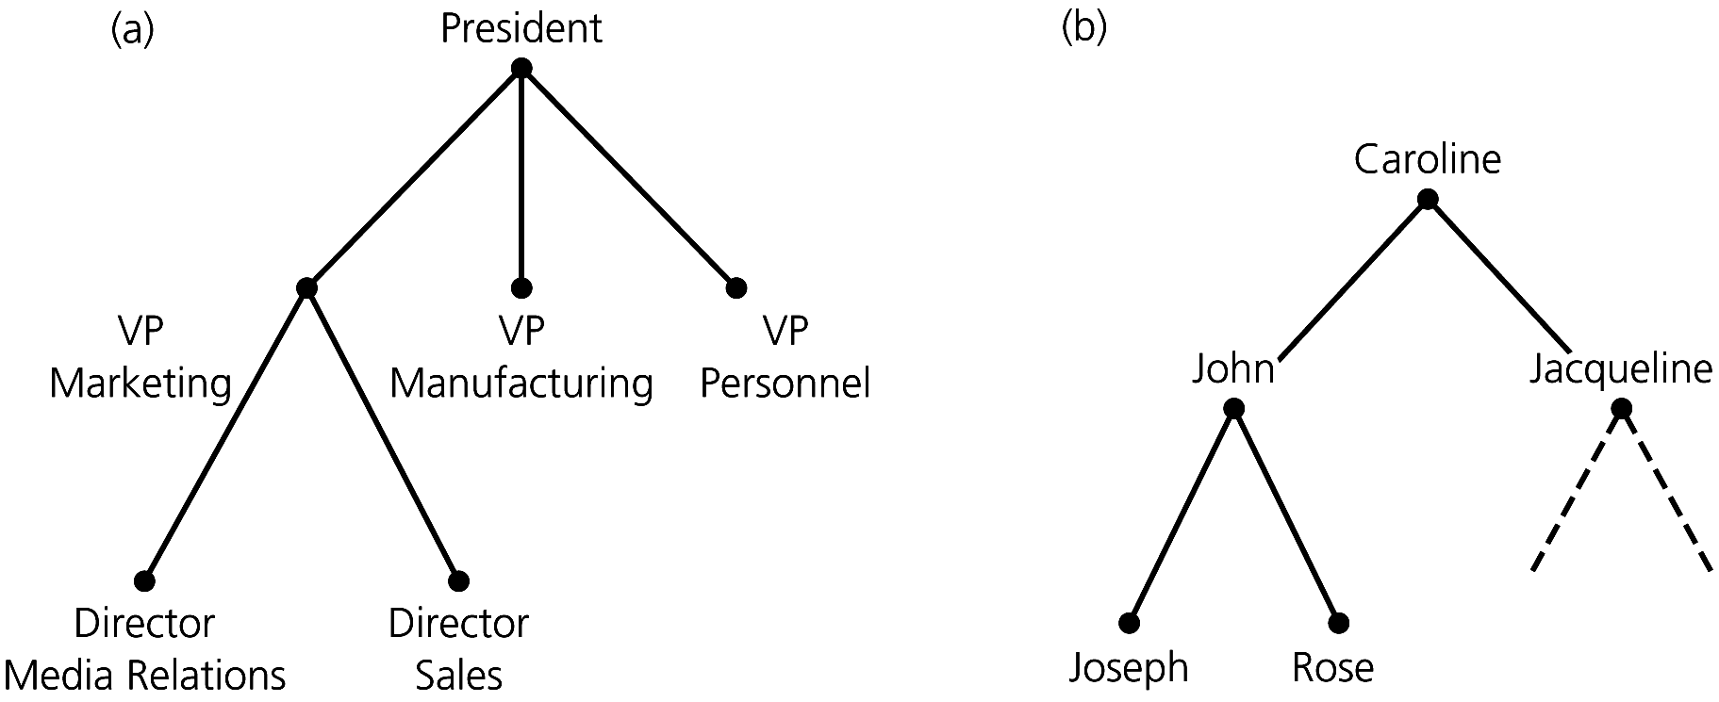
Trees

Slide 5
Binary Tree
A binary tree is a set T of nodes such that either
T is empty, or
T is partitioned into three disjoint subsets:
A single node r, the root
Two possibly empty sets that are binary trees, called the left subtree of r (T_{L}) and the right subtree of r (T_{R})

Slide 6
Binary Search Tree
A binary search tree
A binary search tree that has the following properties for each node n
n’s value is > all values in n’s left subtree T_{L}
n’s value is < all values in n’s right subtree T_{R}
Both T_{L} and T_{R} are binary search trees
All elements are unique (no duplicate elements)

Slide 7
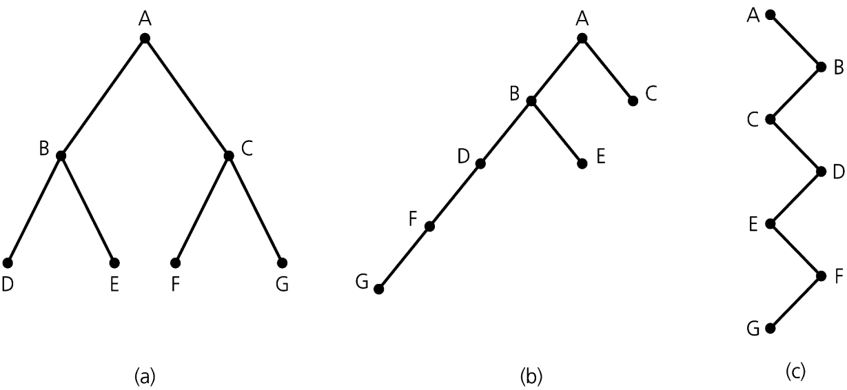
The Height of a Tree
Number of nodes along the longest path from the root to a leaf
Height 3 Height 5 Height 7

Slide 8
Tree Traversal
Preorder traversal
Visit root before visiting its subtrees
i. e. Before the recursive calls
Inorder traversal
Visit root between visiting its subtrees
i. e. Between the recursive calls
Postorder traversal
Visit root after visiting its subtrees
i. e. After the recursive calls

Slide 9
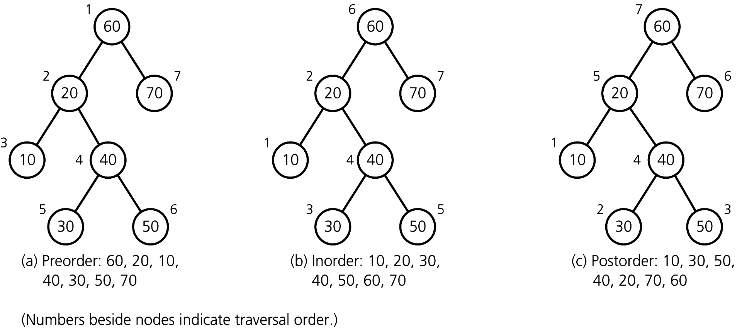
Tree Traversal Example

